Slide 1
Couples
Dr. Jacob Moore
Associate Professor of Engineering
Penn State Mont Alto

Slide 2
Couples
A couple is a set of equal and opposite, but not collinear forces.
This pair of forces exerts no net force on the body, though it will exert a moment.
A
B
1 ft
1 ft
2 ft

Slide 3
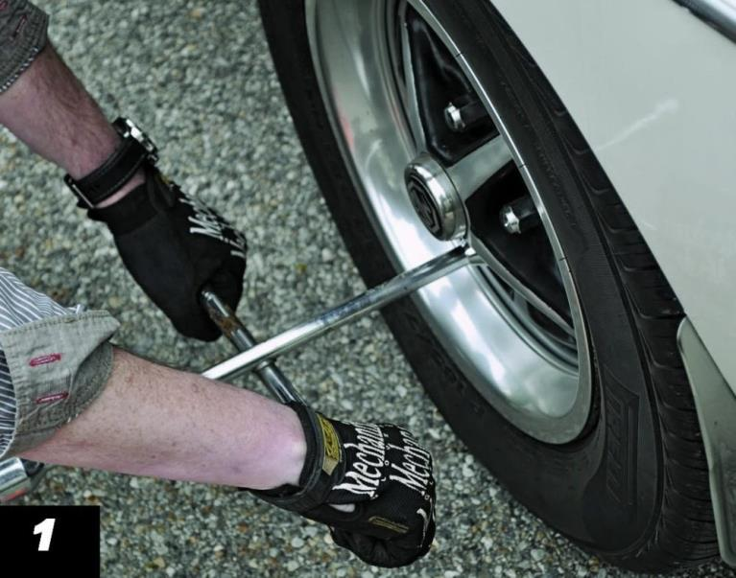
Couples
Because couples exert no net force on the body, they are also sometimes called pure moments
These couples can either be represented as a set of forces, or simply as the moment these forces exert.

Slide 4
Couples
In addition to exerting no net force, couples also have another interesting characteristic, they will exert the same moment about every point.
$$60 lbs$$
A
B
$$60 lbs$$
1 ft
1 ft
2 ft

Slide 5

The Moment of a Couple
$$F$$
A
B
$$F$$
d
$$M=F∗d$$
Where:
M is the moment exerted by the couple at any point.
F is the magnitude of each force.
d is the perpendicular distance between the two lines of action of the force vectors.

Slide 6
Couples
One other thing to look out for is the distance between the force vectors.
This is the minimum (perpendicular) distance between the lines of action of the forces.
d
$$8 kN$$
1.5 m
$$8 kN$$
45º

Slide 7
Thanks for Watching
See other engineering mechanics videos and access the full tool at…

Slide 8
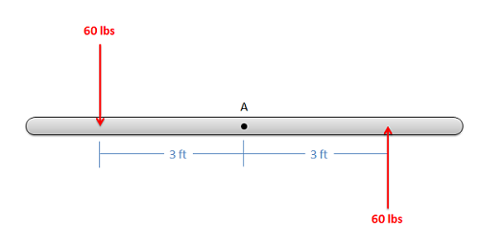
Couple Worked Example
Find the moment exerted by the couple shown in the diagram below.

Slide 9
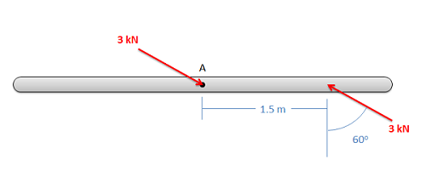
Couples Practice Problem
Find the moment that the couple in the diagram below exerts.

